Slide 1

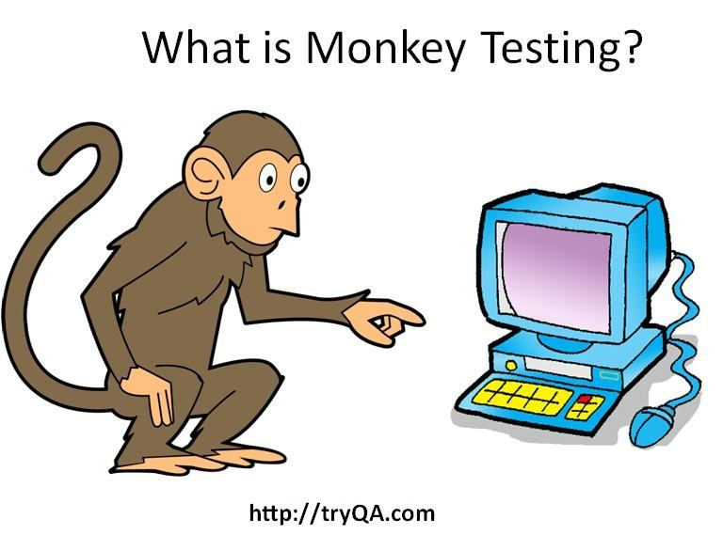


Software Testing : Monkey Runner
Monkey Testing
Group Members
Hifsa Basharat (45903)
Haris Anwer (45902)
Muhammad Laraib Kiyani (45916)
Submitted to
(Ms. Sumeera Hashmi)
Computer Science Department
BSIT Fall 2019

Slide 2
Introduction
Software Testing : Monkey Runner
Monkey Testing
User tests the application or system by providing random inputs and checking the behavior or seeing whether the application or system will crash.
3 Modules:
Monkey Runner (class of utility methods for monkey runner programs)
Monkey Device (device or emulator)
Monkey Image (screen capture image)
Monkey Runner?
It is a tool which provides an API for writing programs that control an android device or emulator. It is a python-based test tool, used to run python scripts for testing android applications.

Slide 3

How to do Monkey Testing?
Software Testing : Monkey Runner
Pre- Requisites
Android SDK
Monkey Runner API in Android Studio
Android Debug Bridge
Android APK/Project to be tested
Emulator/ Virtual AVD
Android drivers
Python.exe

Slide 4
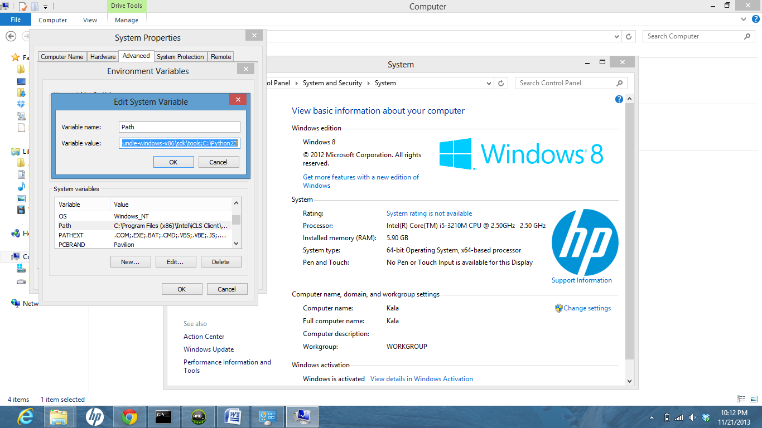
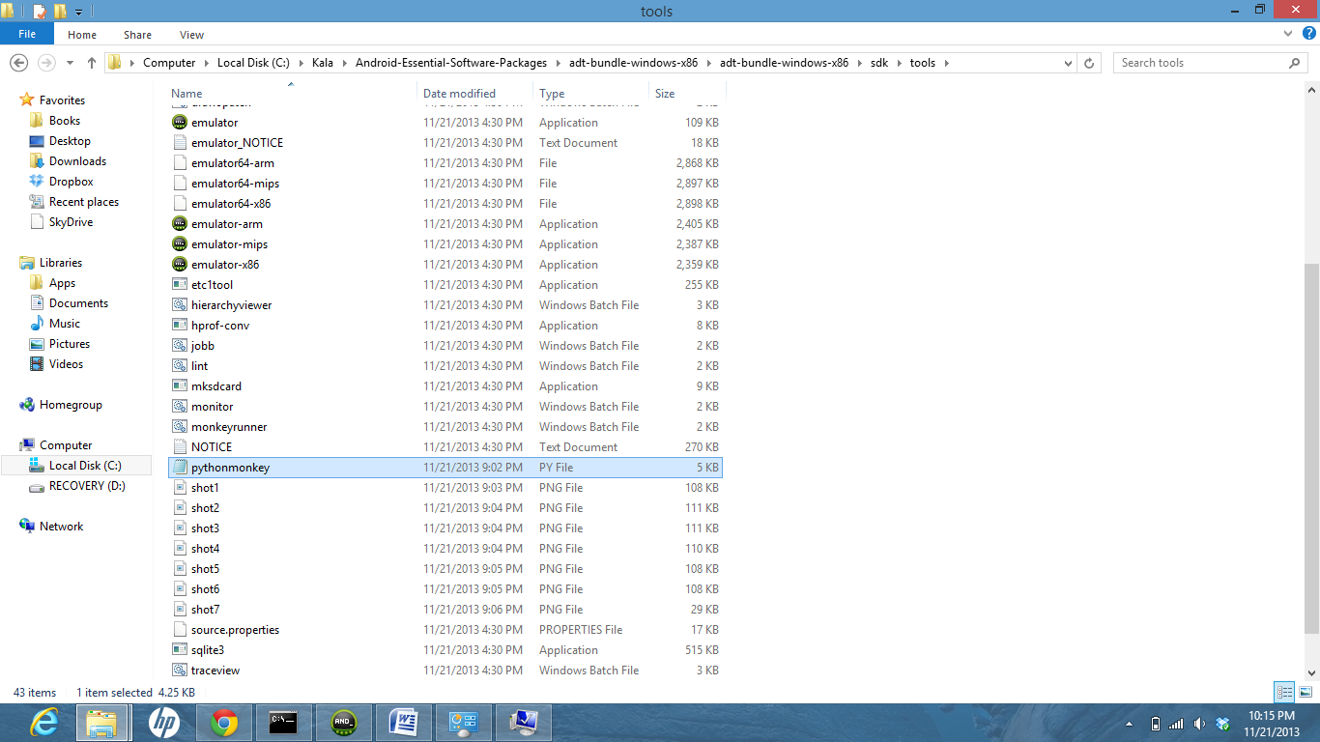
Software Testing : Monkey Runner
Step 1: Set the path of Python in the system path variable
Step 2 : Write the python script and place it inside the tools folder of SDK

Slide 5
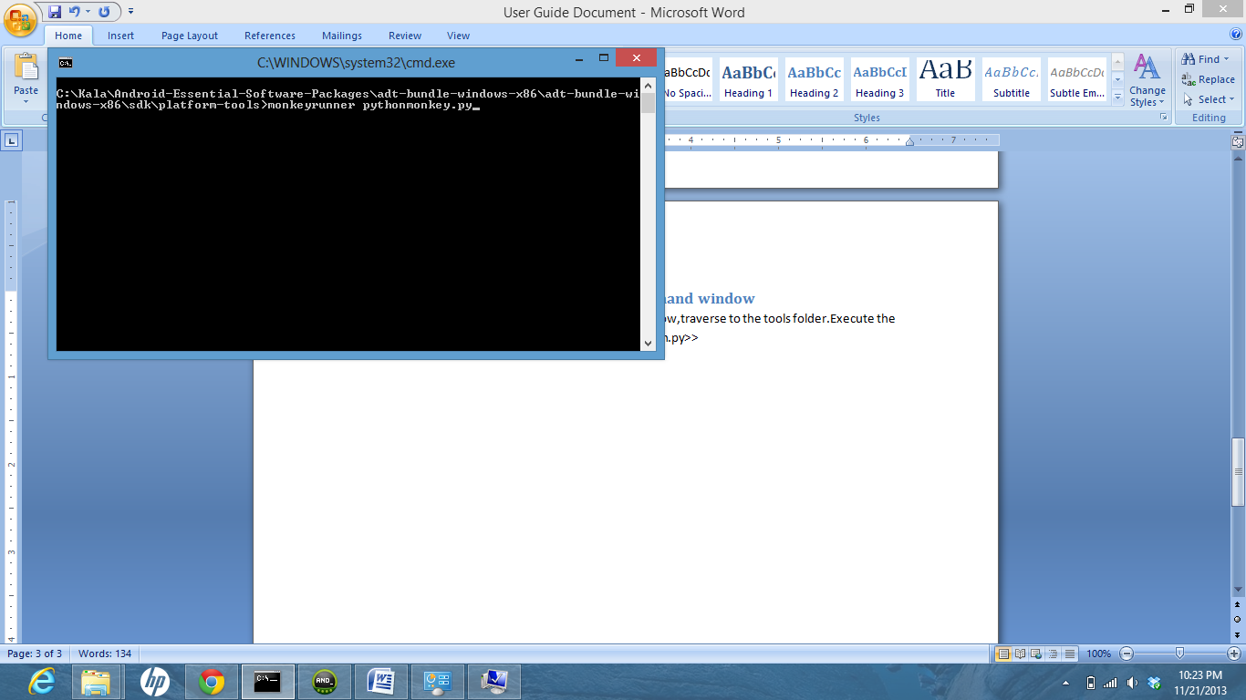
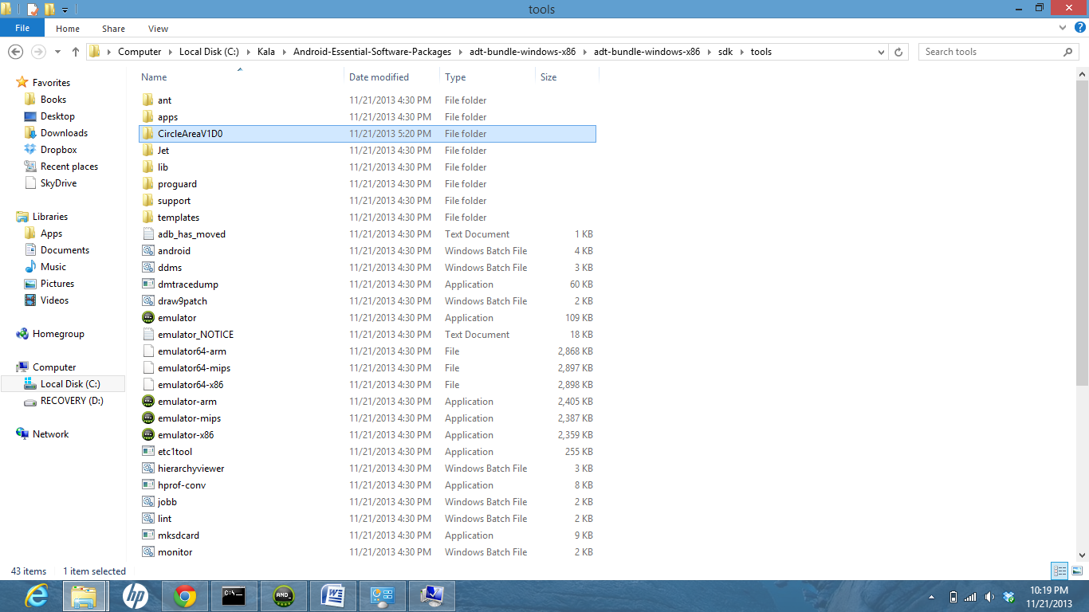
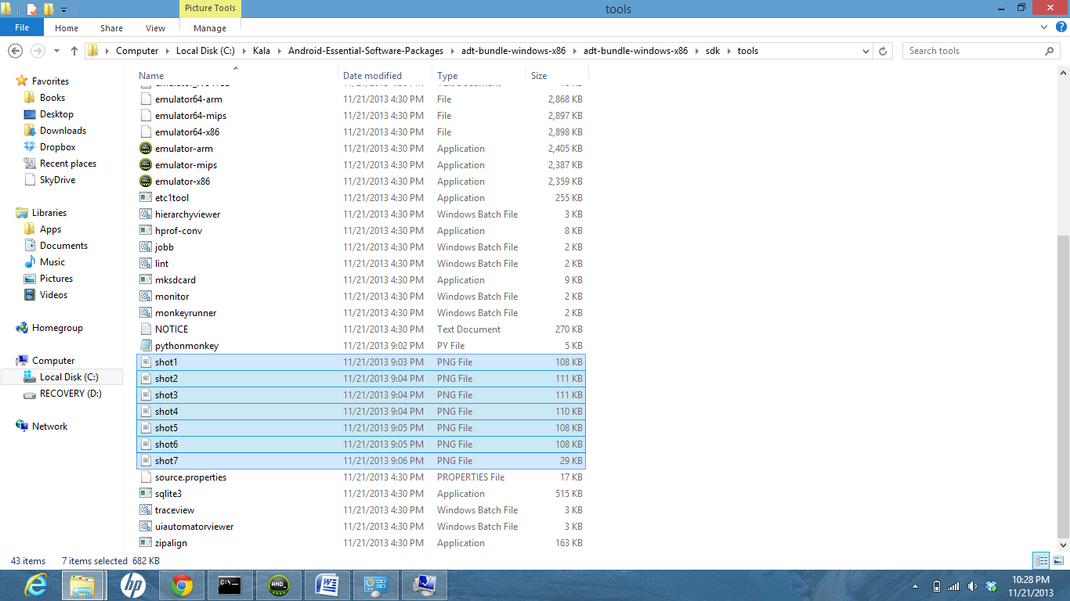
Software Testing : Monkey Runner
Step 3: Place the project folder of your application in the same folder
Step 4: Execute the python script in the command window
Step 5: Screenshot generation in the tools folder and verify whether they are as expected.

Slide 6
FLOW
Software Testing : Monkey Runner
Run .py script from console
screenshots saved to file
Script commands execute
Connection with device is made
Script installs .apk file on device

Slide 7
Monkey testing of Circle Radius Application
Python Script
com.android.monkeyrunner import MonkeyRunner, MonkeyDevice, MonkeyImage
com.android.monkeyrunner.MonkeyDevice import takeSnapshot
com.android.monkeyrunner.easy import EasyMonkeyDevice
device = MonkeyRunner.waitForConnection() //connects to the current device
easy_device=EasyMonkeyDevice(device)
easy_device.installPackage('CircleAreaV1D0/bin/CircleAreaV1D0.apk’) //install android package
activity = 'com.example.circlearea.AreaCircle’ // sets a variable with the name of an Activity
runComponent = package + '/' + activity //sets the name of the component to start
easy_device.startActivity(component=runComponent) //Runs the component
MonkeyRunner.sleep(5)
device.press('KEYCODE_MOVE_END', MonkeyDevice.DOWN_AND_UP) //Press the calculate Button-without error
device.type('12.2’)
easy_device.touch(By.id("id/calculate"), MonkeyDevice.DOWN_AND_UP)
result = device.takeSnapshot()
result.writeToFile('./shot1.png', 'png’)

Slide 8
Monkey testing of Circle Radius Application
Continued..
device.press('KEYCODE_MOVE_END', MonkeyDevice.DOWN_AND_UP) //Press calculate Button (Pi length more than 16)
device.press('KEYCODE_DEL', MonkeyDevice.DOWN_AND_UP)
device.type('17’)
easy_device.touch(By.id("id/calculate"), MonkeyDevice.DOWN_AND_UP)
MonkeyRunner.sleep(5)
result = device.takeSnapshot()
result.writeToFile('./shot2.png', 'png')
device.press('KEYCODE_TAB', MonkeyDevice.DOWN_AND_UP) //Press calculate Button-with error(Radius is empty)
device.press('KEYCODE_MOVE_END', MonkeyDevice.DOWN_AND_UP)
device.press('KEYCODE_DEL', MonkeyDevice.DOWN_AND_UP)
easy_device.touch(By.id("id/calculate"), MonkeyDevice.DOWN_AND_UP)
MonkeyRunner.sleep(5)
result = device.takeSnapshot()
result.writeToFile('./shot3.png', 'png’)
easy_device.touch(By.id("id/exit"), MonkeyDevice.DOWN_AND_UP) //Press the exit Button
MonkeyRunner.sleep(5)
result = device.takeSnapshot()
result.writeToFile('./shot4.png', 'png')
Repeat all the steps discussed previously with above script & circle radius application..

Slide 9
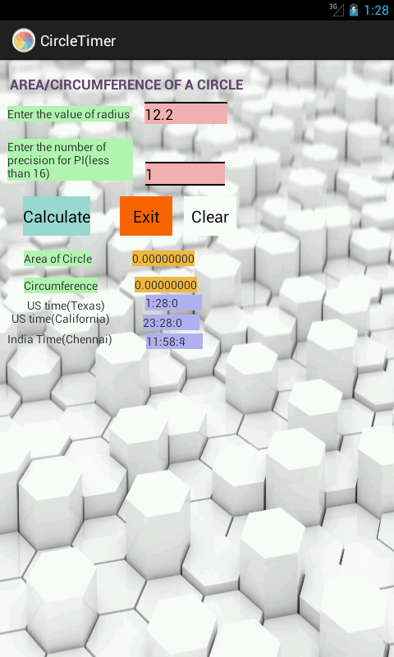
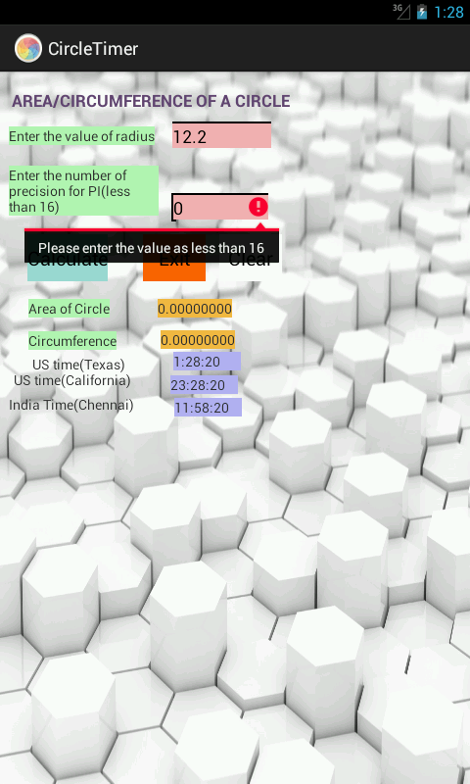
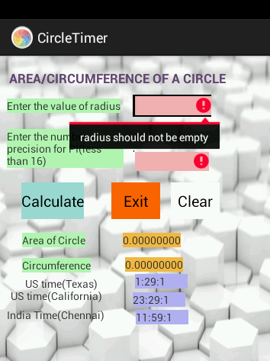
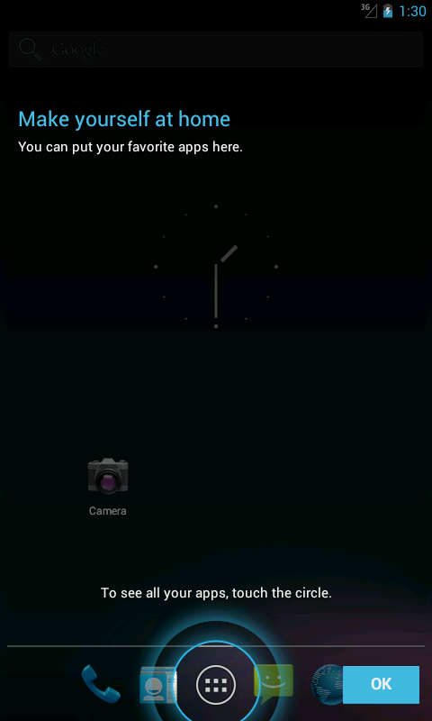
Testing Results/ Screenshots (Circle Radius Application)
Software Testing : Monkey Runner
Press the calculate Button-without error
Pressing calculate Button with error( Pi length not more than 16)
Pressing calculate Button with error( Radius cannot be empty)
Pressing exit Button

Slide 10
Software Testing : Monkey Runner
Limitations
Less Accuracy:
Tester cannot define exact test scenario and even cannot guarantee the accuracy of test cases
Requires very good technical expertise:
It is not worth always to compromise with accuracy, so to make test cases more accurate testers must have good technical knowledge of the domain
Fewer bugs and time consuming:
This testing can go longer as there is no predefined tests and can find less number of bugs which may cause loopholes in the system

Slide 11
References
Software Testing : Monkey Runner
https://www.google.com/search?q=monkey+runner+presentation+slide+share&oq=monkey+runner&aqs=chrome.0.69i59j0j69i57j69i60j69i59j69i60.6878j0j4&sourceid=chrome&ie=UTF-8
https://www.slideshare.net/ContusQA/monkey-talk-automation
https://www.google.com/search?ei=nSTpXfOQAYqFhbIPstKd8AU&q=monkey+runner&oq=monkey+runner&gs_l=psy-ab.3..0i10j0j0i10l2j0.6881.7146..7467...0.0..0.309.991.0j1j2j1......0....1..gws-wiz.zPTholLix8k&ved=0ahUKEwiz07PX657mAhWKQkEAHTJpB14Q4dUDCAs&uact=5
https://developer.android.com/studio/test/monkeyrunner
https://medium.com/@soonsantos/guide-to-run-monkeyrunner-e9363f36bca4
Computer Science Department
BSIT Fall 2019

Slide 12

Software Testing : Monkey Runner
Any Question??

